Slide 1
ECEN 404:
Active Ankle-
Foot Orthosis (AAFO)
Alfred Boss
Christopher Galik
Tyler Pierce

Slide 2
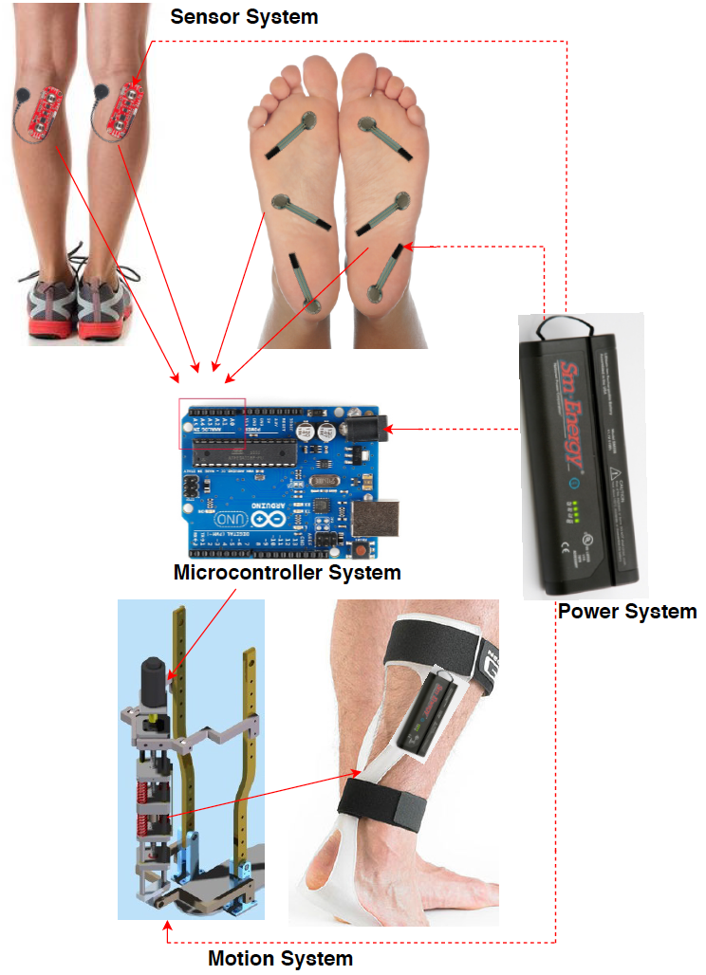
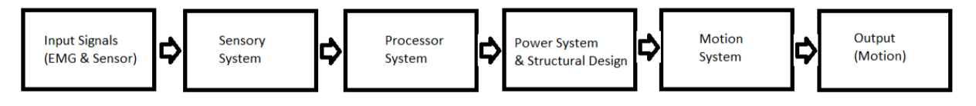
System Overview
EMG sensors and FSR sensors will measure electrical activity and pressure in the leg and foot.
The AAFO will transport signals from the 2 sensors to the MCU.
The microcontroller will interpret signals and determine which stage of gait the user is in and supply corresponding motor control.
The motion system, which acts as an artificial muscle, will move the joint by attaching to a rigid structure.

Slide 3
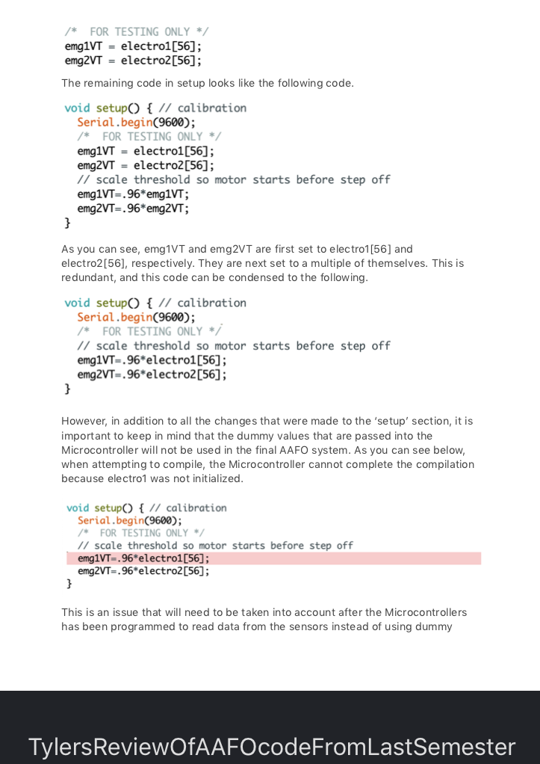
Sensor & MicroController System
Bi-Weekly Accomplishments
Validated FSR sensors against Tekscan documentation and identified tests
Analyzed, Commented, and Edited Arduino code and Integrated with sensor code
Redesigned FSR sensor and structure integration
Began designing sensor system to operate on PCB
Ongoing progress/problems
Validation tests and plan must be more thoroughly detailed and new tests identified
Sponsor requested new temperature sensor and addition of LEDs to overall system

Slide 4
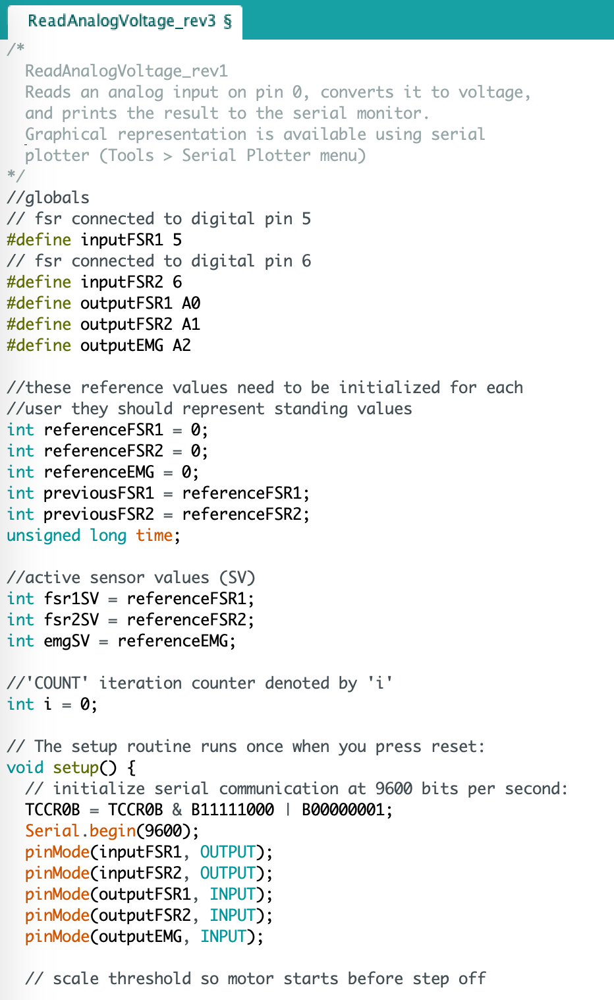
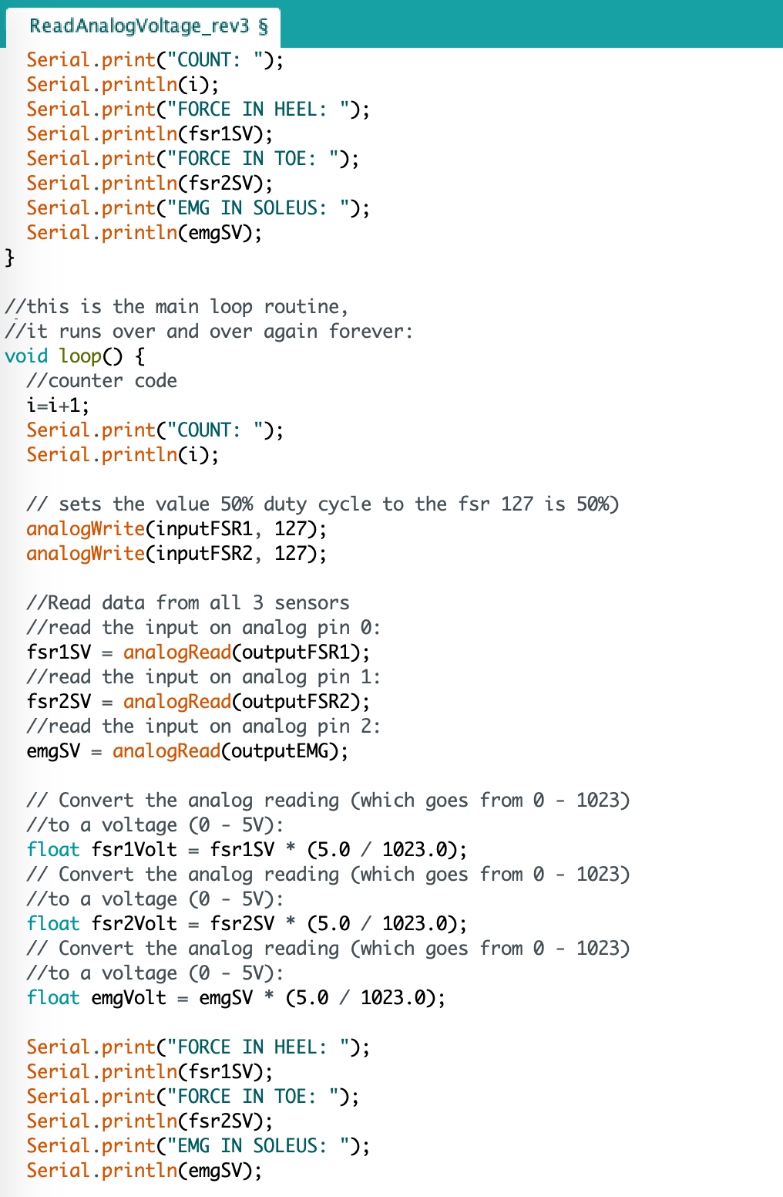
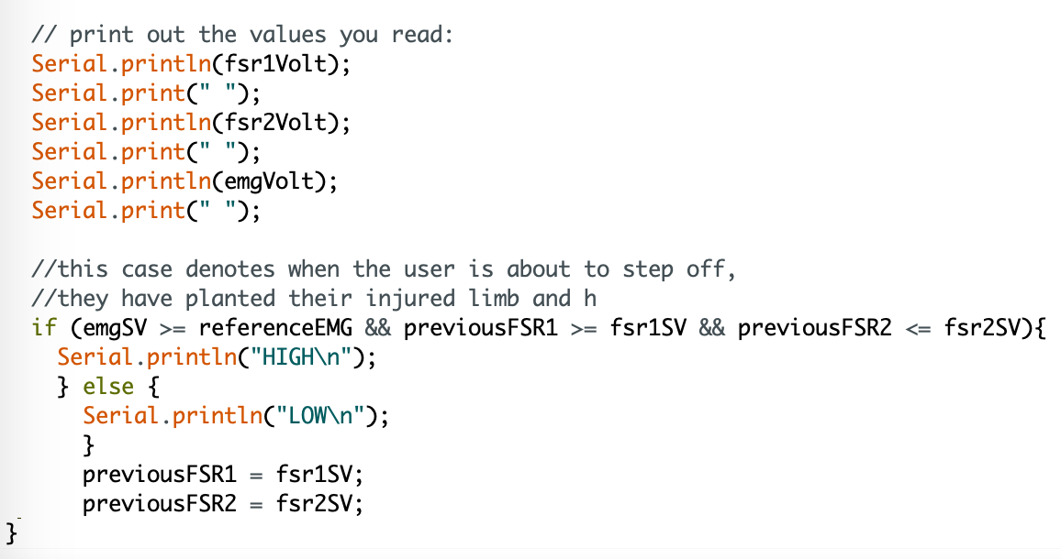
This represents the integrated microcontroller code and sensor code from last semester. This is a rough integration of these two subsystems and will need to be further refined (and additional sections will be added to it) in the coming weeks.

Slide 5
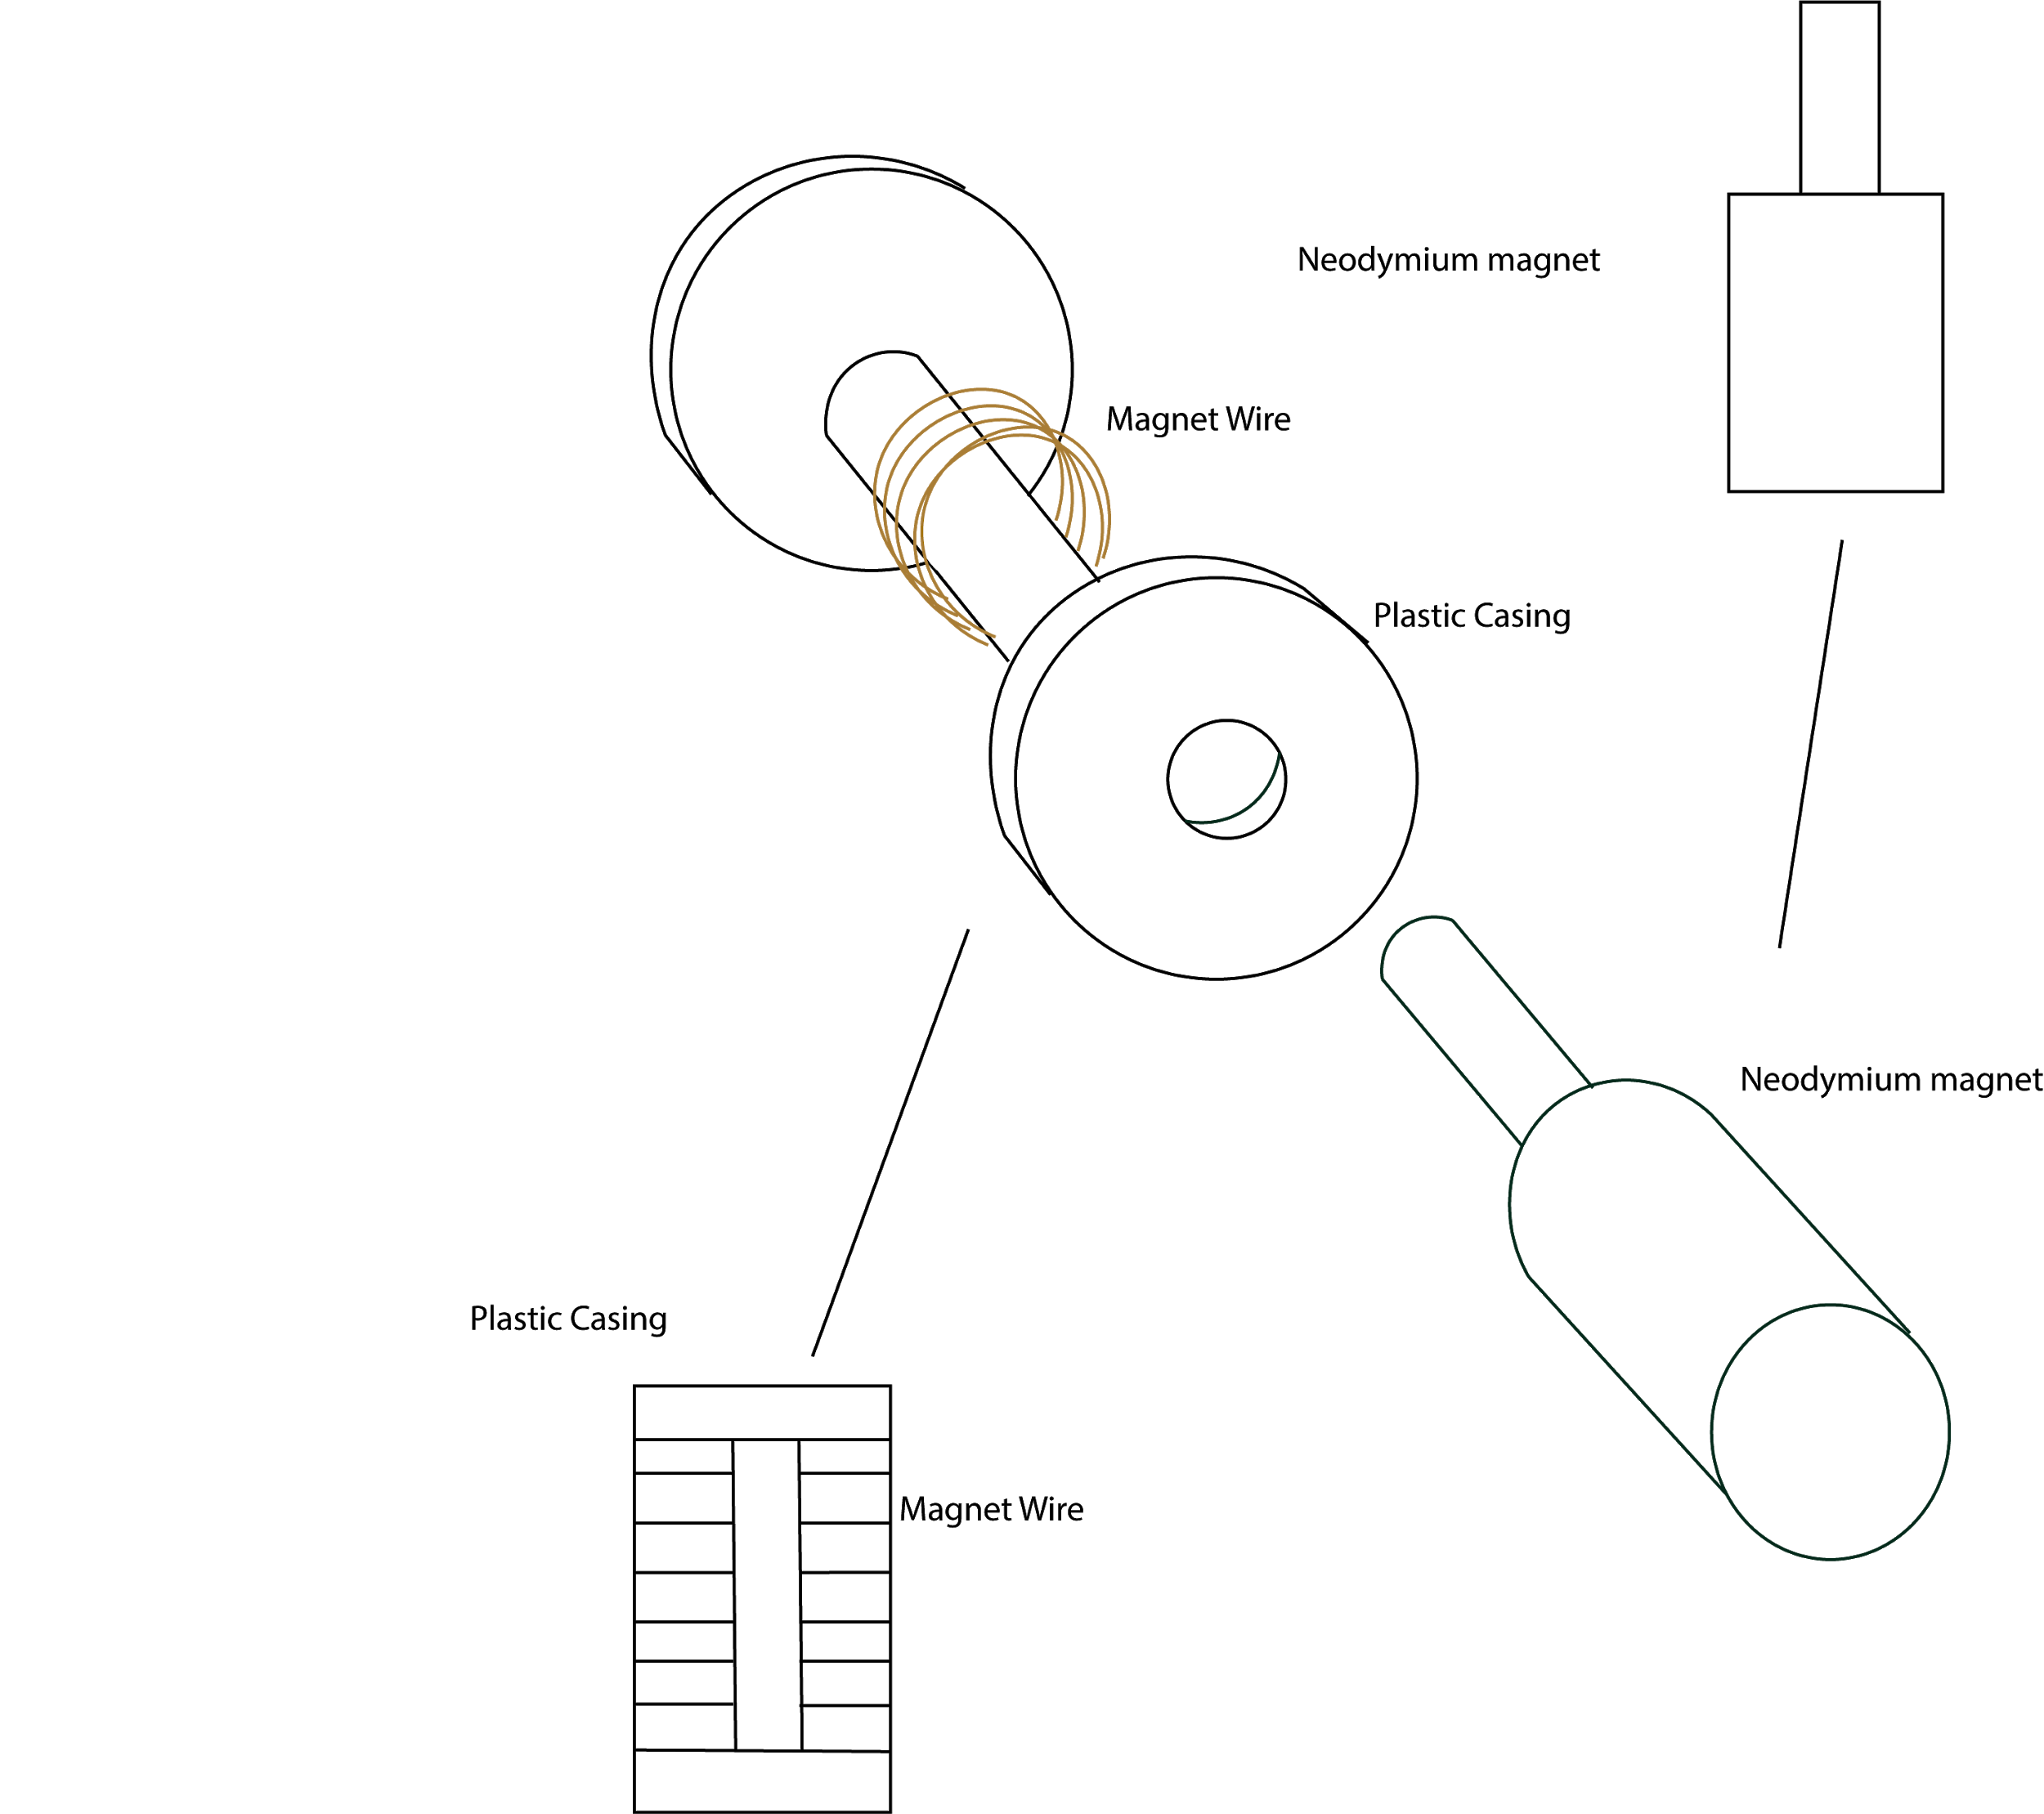
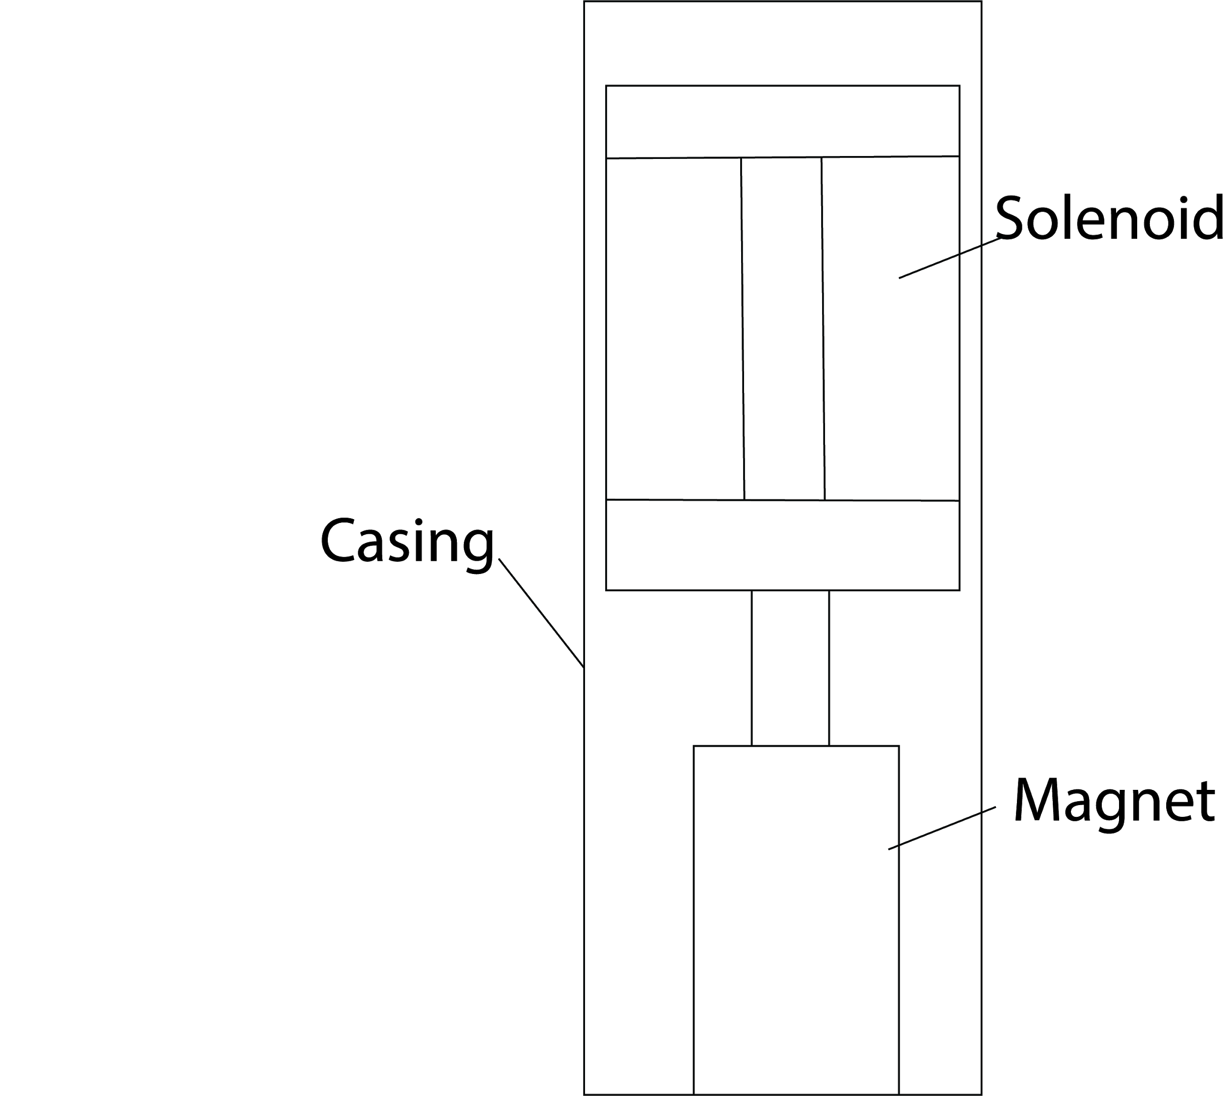
Artificial Muscle/Motion System Development
Bi-Weekly Accomplishments
3D print for structure integration Initiated
Ongoing progress/problems
Acquire Newtonmeter to assist in validation
Final Validation for A.M. in and out of structure system with newtonmeter

Slide 6
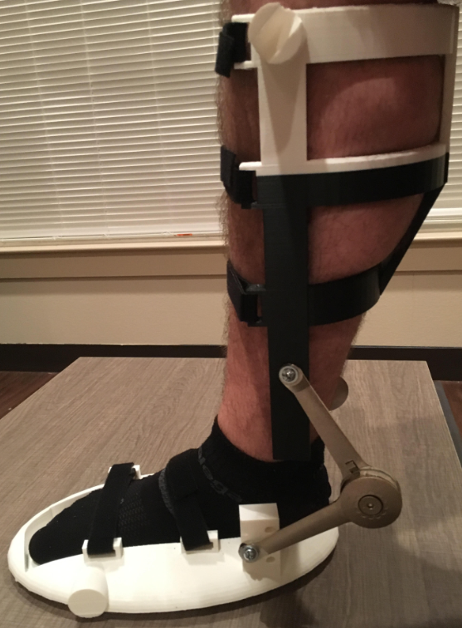
Structural Design
Bi-Weekly Accomplishments
3D print & additional materials completed
Validation: Foot dimensions fit, Leg dimensions fit,
Holds body weight, able to walk with it, ankle rotation
Ongoing progress/problems
Solidworks stress validation
Integrate structure with Artificial Muscle and test
Comfort modifications to be made to final structure

Slide 7

Structure Prototype Validation
Walking
Ankle Rotation

Slide 8
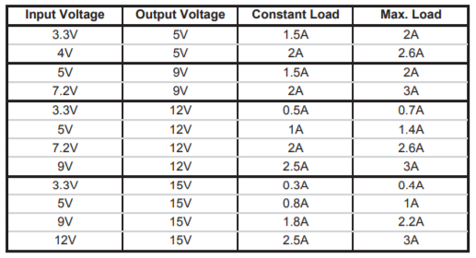
Power System
Bi-Weekly Accomplishments
Power Requirement: 3 Amps constant
Pre-built option: Matek Systems Voltage Booster, $7.13
Ongoing progress/problems
Current source?
Simulation validation during shipment
Operational validation
Notes:
10 pins power req for MC, 0.7A for max current needed for AM, 0.65 minimum, switch solution for speed control

Slide 9
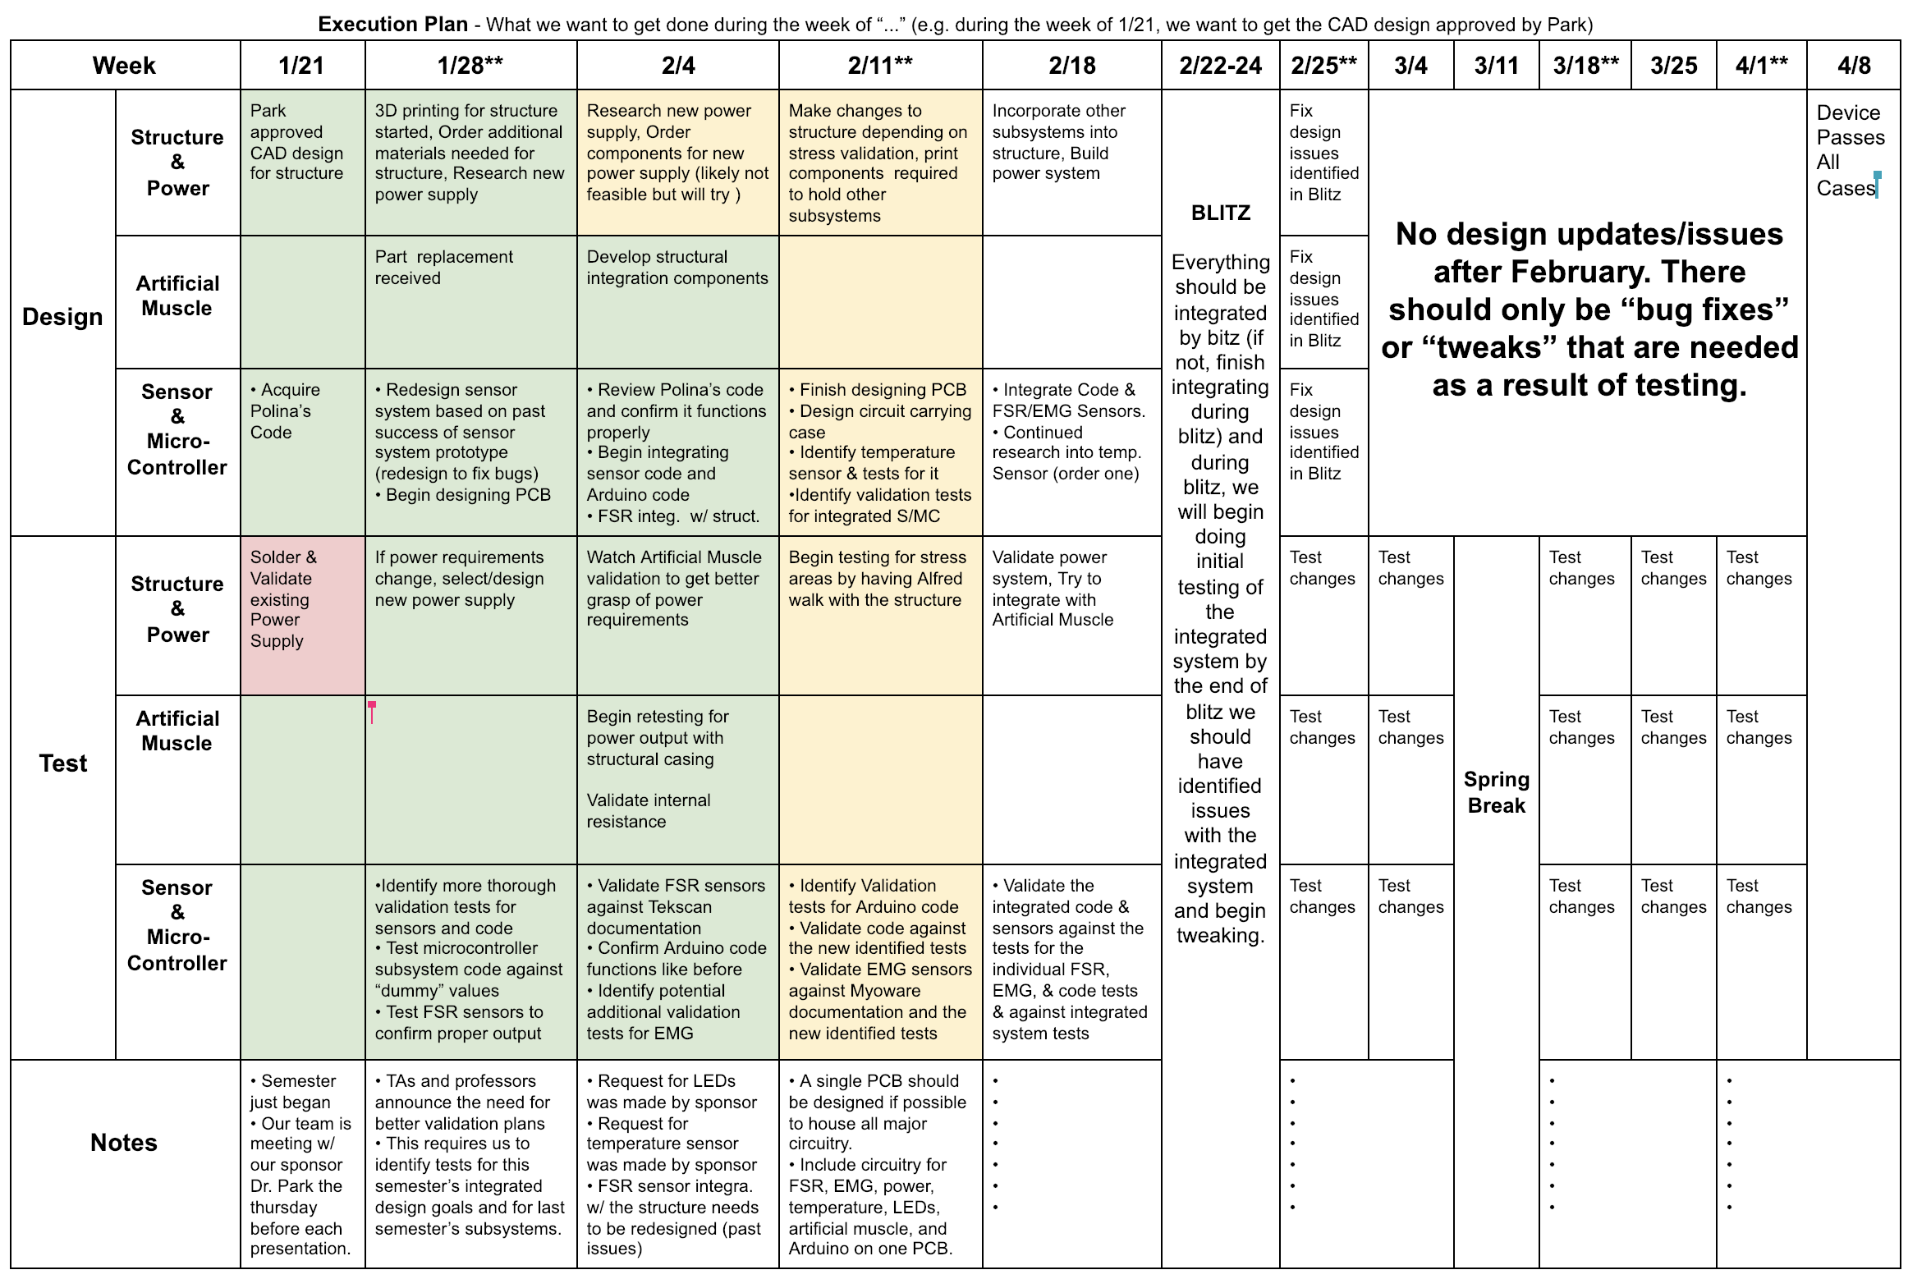
Execution Plan

Slide 10
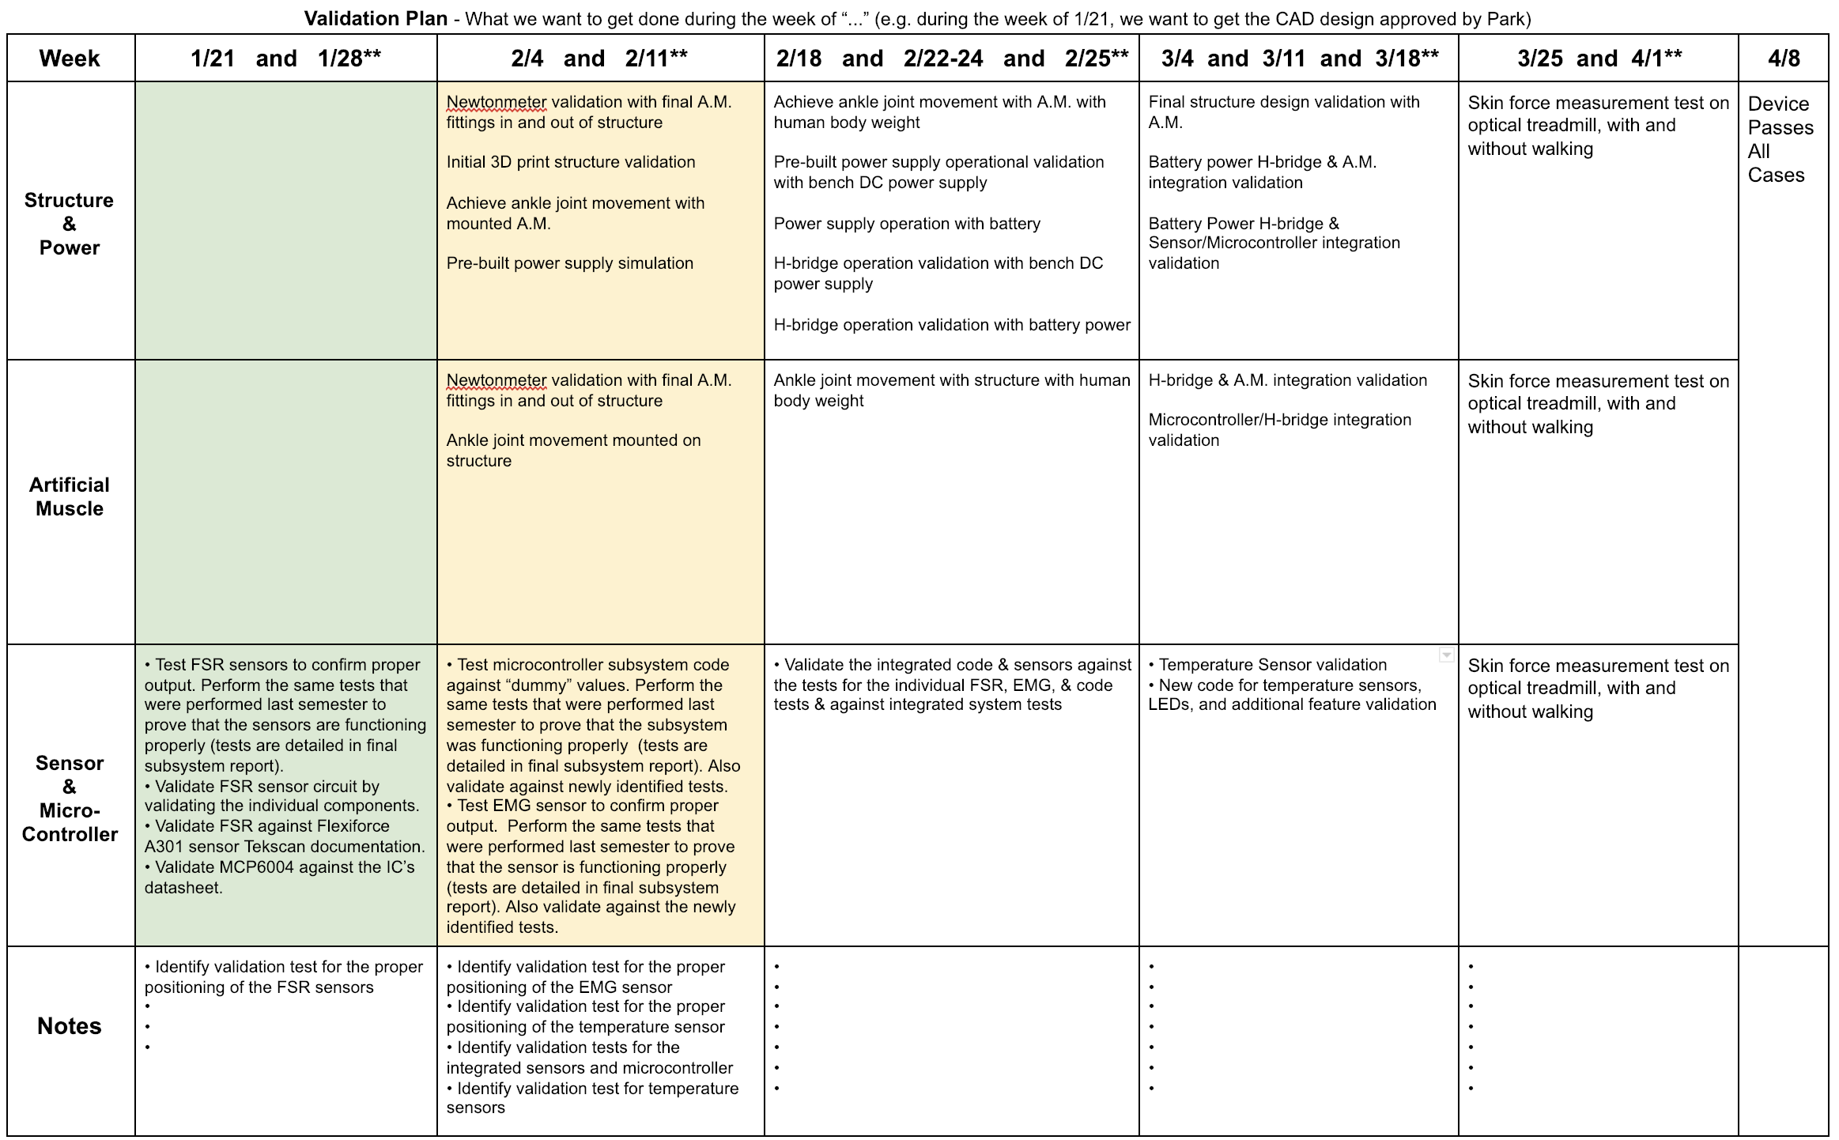
Validation Plan

